Slide 1
Master’s Project Pitch
Josh Bailey

Slide 2
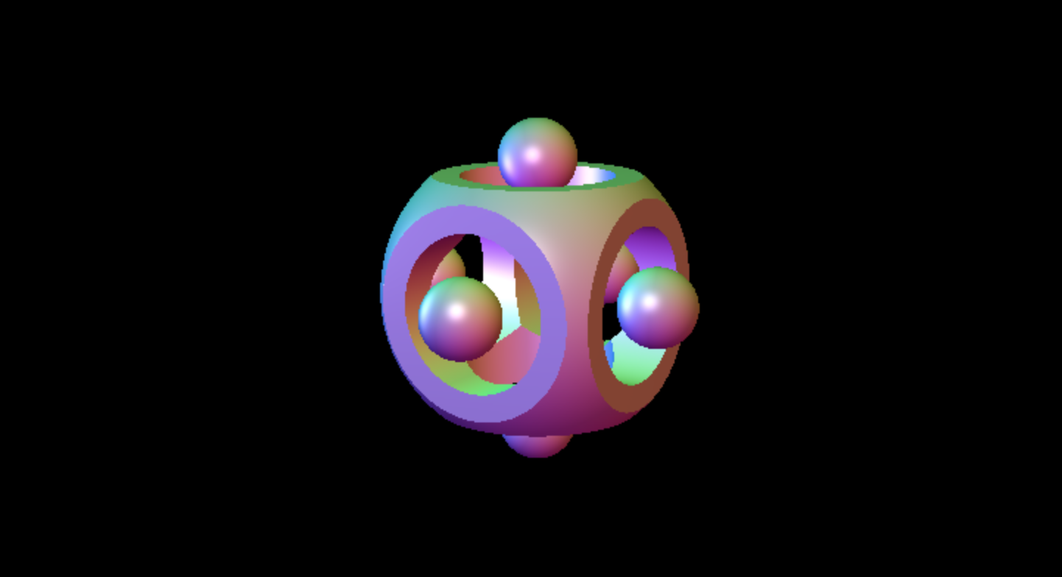
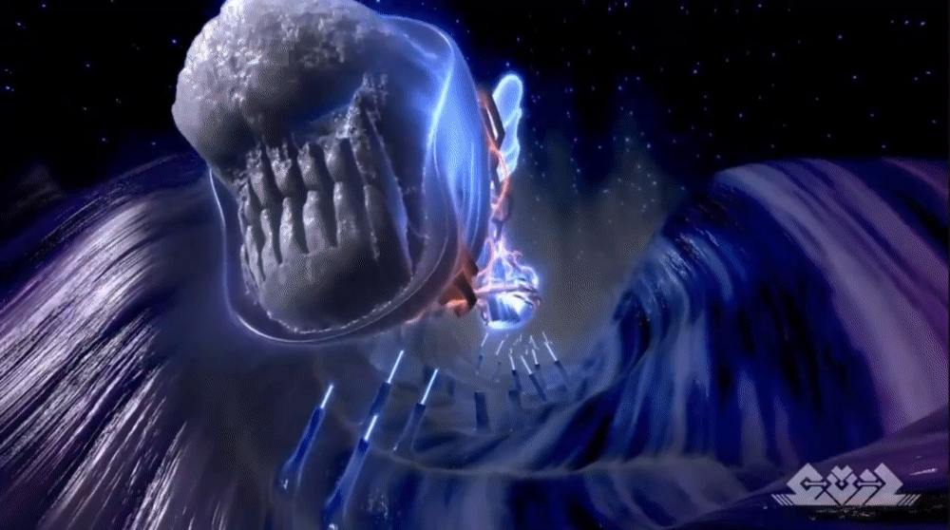
Ray Marching / Sphere Tracing
Implicit surface modelling
Creating procedural environments

Slide 3
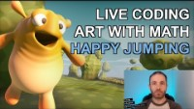
Maths = Art
https://www.shadertoy.com/

Slide 4
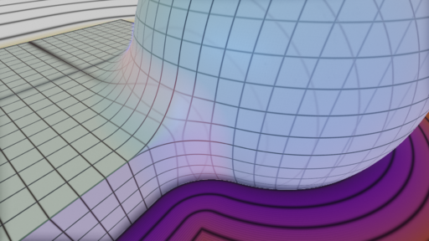
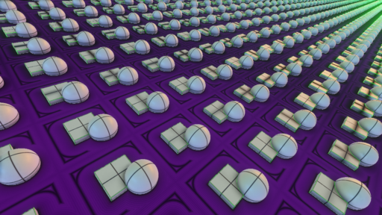
‘ShaderToy’ Application / Library
Help bridge the gap between programmer and artist
No requirement of a mathematical background
Collection of Signed Distance Functions (SDFs)
Space-folding Operators
Boolean Operators
https://mercury.sexy/hg_sdf/
https://hyperfun.org/frep/main

Slide 5
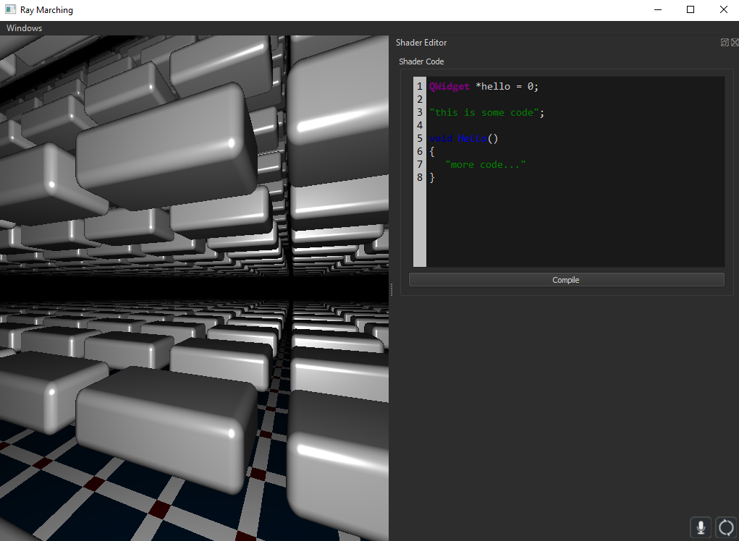

Slide 6
Mesh Extraction
Is it possible to extract the mesh of a single frame from a procedural environment?
Marching Cubes
Dual-Contouring

Slide 7
Relevant Papers
Ray Tracing Deterministic 3D Fractals - https://www.evl.uic.edu/hypercomplex/html/book/rtqjs.pdf
Ray Tracing Quaternion Julia Sets on the GPU - https://www.cs.cmu.edu/~kmcrane/Projects/QuaternionJulia/paper.pdf
Field Functions for Implicit Surfaces - https://link.springer.com/article/10.1007/BF01901483

